Slide 1
Networking Fundamentals for DevOps Engineers
Pramoth Ravi

Slide 2
Networking concepts every Devops engineer should know:
1. OSI Model
2. Protocols : TCP/UDP/IP
3. Ports
4. Subnetting
5. Routing
6. DNS
7. VPN (Virtual Private Network)
8. Networking tools

Slide 3
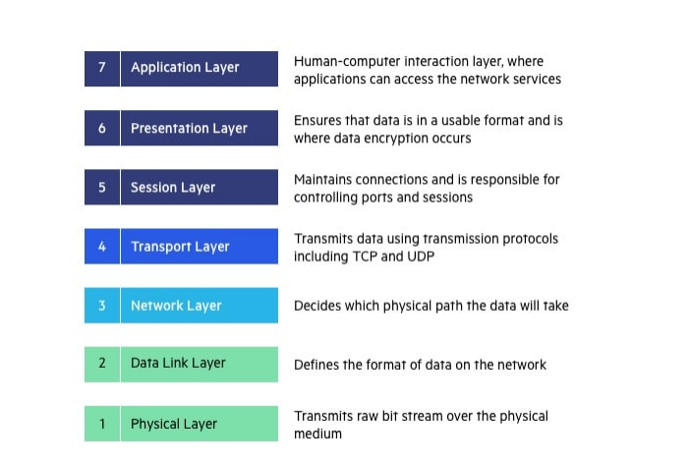
OSI Model : Learning Resource

Slide 4
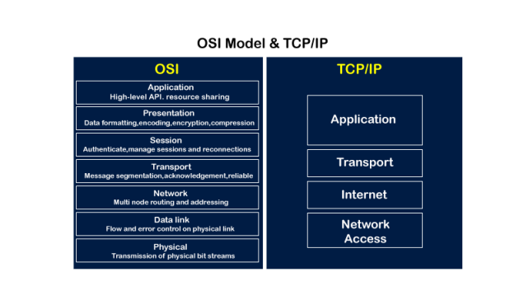

Slide 5
Protocols :
A protocol is a set of rules that defines how data is transmitted and received between devices in a network. It ensures standardized communication, allowing different systems to understand and interact with each other. Examples include TCP/IP, HTTP, and SMTP.

Slide 6
TCP (Transmission Control Protocol):
Description: TCP operates at the transport layer of the OSI model. It establishes a connection between two devices before data exchange, ensuring reliable and ordered delivery of information.
Functionality: It breaks data into packets, assigns sequence numbers, and uses acknowledgment messages to guarantee delivery. It's connection-oriented, meaning it sets up, maintains, and terminates a connection for data exchange.

Slide 7
UDP (User Datagram Protocol):
Description: Also operating at the transport layer, UDP is a connectionless protocol that offers minimal services. It's like a 'fire and forget' approach for data transmission.
Functionality: It sends data without establishing a connection, providing lowlatency communication. However, it doesn't guarantee delivery or order, making it suitable for real-time applications like video streaming or online gaming

Slide 8
IP (Internet Protocol):
Description: IP functions at the network layer and is a fundamental part of the TCP/IP protocol suite. It handles addressing and routing to ensure data packets reach their intended destinations.
Functionality: IP assigns unique IP addresses to devices and uses routing tables to direct data across networks. It's responsible for the logical connection between different devices on the Internet

Slide 9
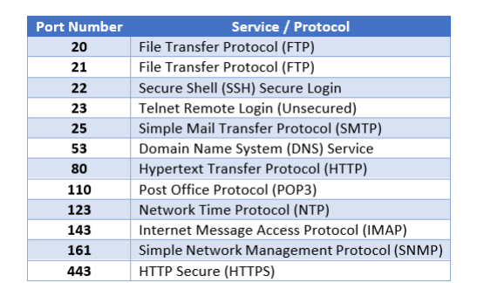
Ports
Ports are communication endpoints that allow different services on a device to send and receive data.

Slide 10
Subnetting (CIDR)
DevOps engineers should understand IP addressing, subnetting, and CIDR notation. This knowledge is crucial for designing and managing IP address spaces effectively.
Subnetting is a technique used in computer networking to divide a larger IP network into smaller, more manageable sub-networks or subnets.

Slide 11
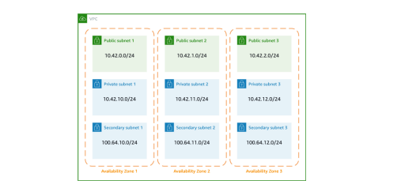
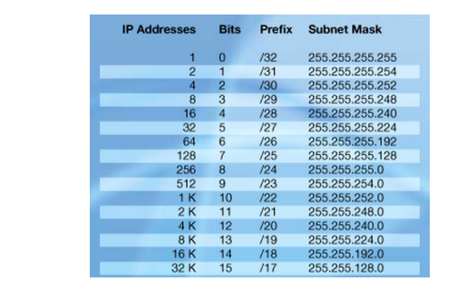

Slide 12
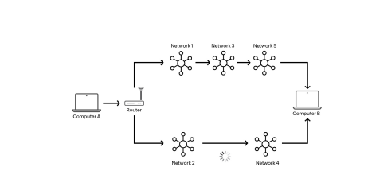
Routing
Routing is the process of directing data packets from a source to a destination across a network. Routers use routing tables and protocols to decide the path for data transmission, ensuring efficient and reliable communication between devices.

Slide 13
DNS
DNS, or Domain Name System, translates easy-to-remember domain names to computer-friendly IP addresses, helps find mail servers, balances web traffic among servers, redirects requests, performs reverse lookups, and speeds up responses through caching. It's a vital system that ensures efficient and reliable communication on the internet.

Slide 14
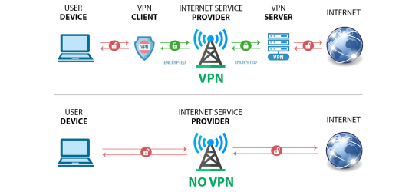
VPN
A VPN, or Virtual Private Network, is like a secure tunnel for your internet connection. It encrypts your data and routes it through a server, making your online activities more private and secure.

Slide 15
Networking tools
.Ping: Networking for DevOps Engineers! 10
Purpose: To check the reachability of a host on an Internet Protocol (IP) network.
Usage Example: ping google.com

Slide 16
Traceroute
Purpose: To display the route and measure transit delays of packets across an Internet Protocol network.
Usage Example: traceroute google.com

Slide 17
Nmap:
  Purpose: To discover hosts and services on a computer network, creating a "map" of the network.
  Usage Example: nmap -p 1-1000 target
Tcpdump:
  Purpose: To capture and analyze network traffic.
  Usage Example: tcpdump -i eth0
Ipconfig (Windows) / ifconfig (Linux):
  Purpose: To display the configuration of network interfaces.
  Usage Example (Linux): ifconfig
Nslookup (Windows) / host (Linux):
  Purpose: To query DNS servers for domain information
  Usage Example (Linux): host google.com.
Wireshark:
  Purpose: A network protocol analyzer for troubleshooting and analysis of the interactions between network components.
  Usage Example: Capture and analyze packets on a specific network interface.

